Slide 1

Correlated data, nuisance variables
ENTMLGY 6707
Entomological Techniques and Data Analysis

Slide 2
Learning objectives
Define, identify, and account for nuisance variables
Recognize potential correlations in (the residuals of) response variables
Compare and contrast fixed and random effects

Slide 3
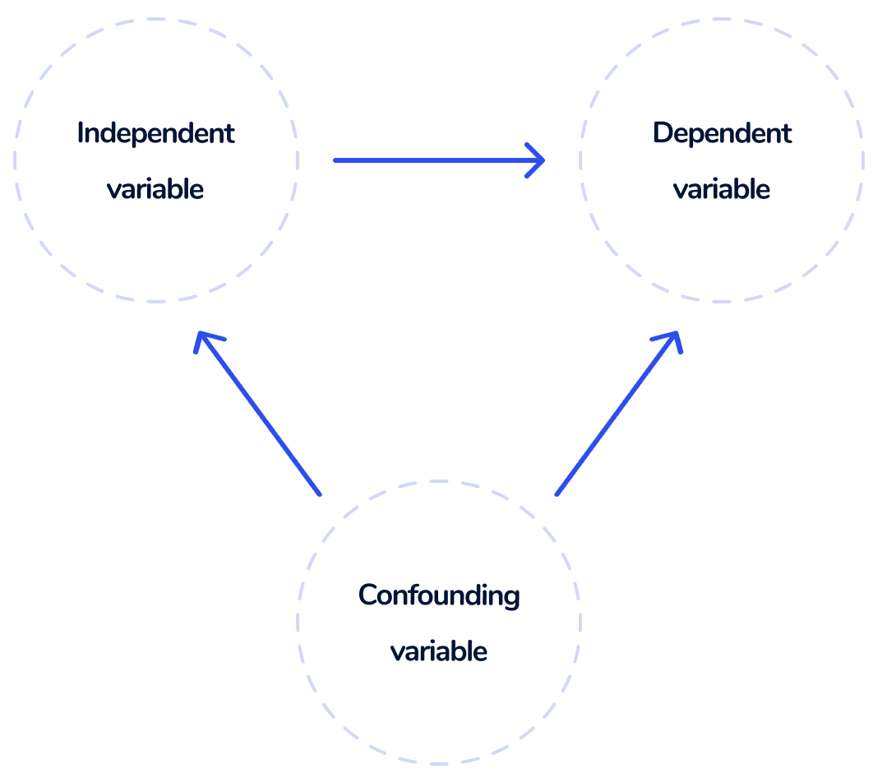
Definition
Confounding variable: influences response and predictor, potentially leading to spurious associations. They obscure…or confound…the relationship between response and predictors.

Slide 4
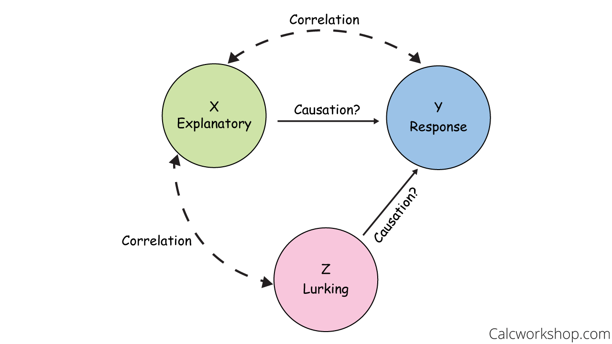
Definition
Nuisance variable: influences (= explains variation in) response variable but not directly relevant to the hypothesis/research question; can be difficult to remove from the experiment. If the NV is unknown (or difficult to measure), we hope randomization will account for its effects. Otherwise, we use blocking and/or fit the NV as a predictor.

Slide 5


Time can be a confounding variable…
Beetle survival on diet A and diet B.
Rep A
Rep B
Obs 1-4
Obs 9-12
Obs 5-8
Obs 13-16
Time

Slide 6
…so, change the design…
Beetle survival on diet A and diet B.
Rep A
Rep B
Obs 1-4
Obs 9-12
Obs 5-8
Obs 13-16
Time

Slide 7
BUT…now time is a nuisance variable
Beetle survival on diet A and diet B.
Rep A
Rep B
Obs 1-4
Obs 9-12
Obs 5-8
Obs 13-16
Time

Slide 8
Activity (don’t submit):
Identify one confounding variable and/or one nuisance variable that could potentially drive variation in a response variable in your study system.

Slide 9
A few slides/comments on spatial and temporal analyses…

Slide 10
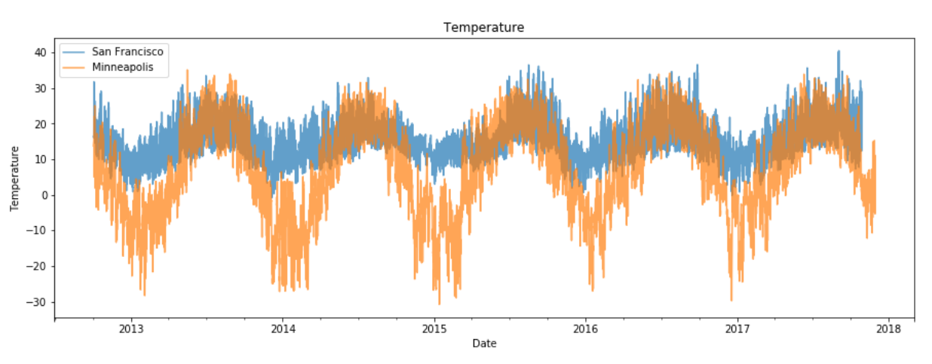
María García Gumbao
Product Data Analyst at Glovo

Slide 11
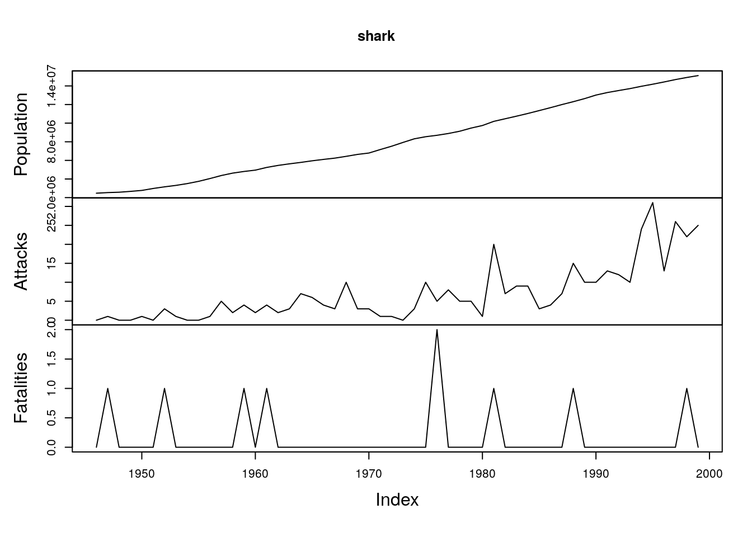
Shark Attacks in Florida
http://www.seec.uct.ac.za/time-series-analysis

Slide 12
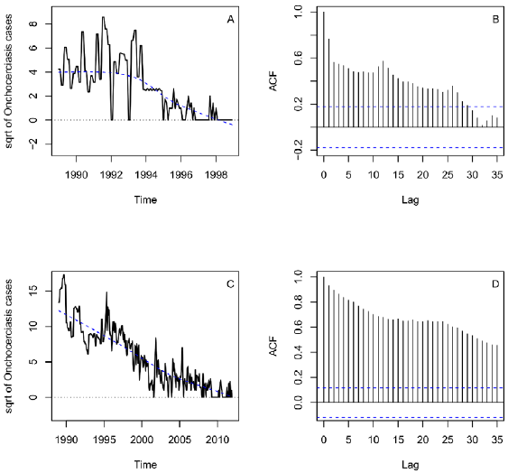

Notes:
Onchocerciasis, or river blindness, is a neglected tropical disease (NTD) caused by the parasitic worm Onchocerca volvulus. It is transmitted through repeated bites by blackflies of the genus Simulium.

Slide 13
Year | Cases | Cases_nolag | Cases_lag1 | Cases_lag2 | Cases_lag3
1991 | 15 | 15 | NA | NA | NA
1992 | 18 | 18 | 15 | NA | NA
1993 | 10 | 10 | 18 | 15 | NA
1994 | 8 | 8 | 10 | 18 | 15
1995 | 6 | 6 | 8 | 10 | 18
1996 | 5 | 5 | 6 | 8 | 10
1997 | 4 | 4 | 5 | 6 | 8
Notes:
Onchocerciasis, or river blindness, is a neglected tropical disease (NTD) caused by the parasitic worm Onchocerca volvulus. It is transmitted through repeated bites by blackflies of the genus Simulium.

Slide 14
Space as a nuisance variable
Beetle survival on cultivar A and cultivar B.
Site 1
Site 2
Obs 1-4
Obs 9-12
Obs 5-8
Obs 13-16
Spatial gradient

Slide 15
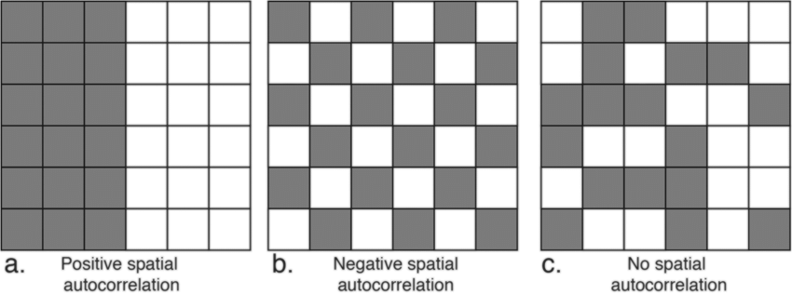


Slide 16
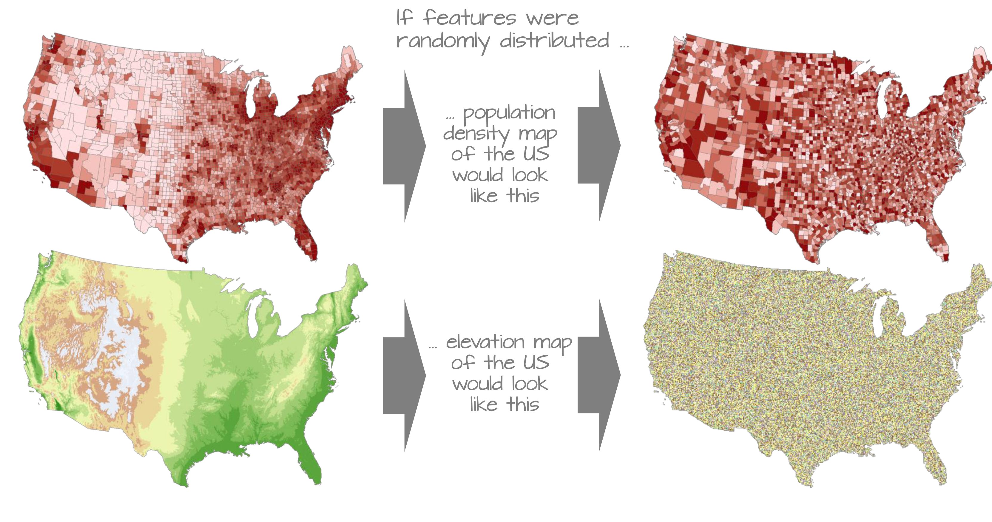
https://mgimond.github.io/Spatial/spatial-autocorrelation.html

Slide 17

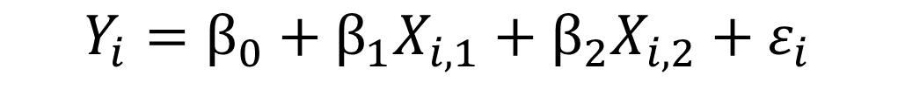
Accounting for nuisance variables
Site 1
Site 2
Obs 1-4
Obs 9-12
Obs 5-8
Obs 13-16
Option 1 (fixed-effects only model):
fit1 <- lm(y ~ site + trt, data= df)
$$Y_{i}=β_{0}+{β_{1}X}_{i,1}+{β_{2}X}_{i,2}+ε_{i}$$
Site effect
Treatment effect
Option 2 (mixed-effects models):
library(lme4)
fit1 <- lmer(y ~ trt + (1|site), data=df)
$$Y_{i}=β_{0}+b_{i}+{β_{1}X}_{i}+ε_{i}$$
Site “effect”
Treatment effect

Slide 18
The modeling frameworks differ conceptually
Option 1 (fixed-effects only model):
fit1 <- lm(y ~ site + trt, data= df)
“Fitting ‘group’ as a fixed effect in model M1 assumes the ‘group’ means are all independent of one another and share a common residual variance.”
Option 2 (mixed-effects models):
library(lme4)
fit1 <- lmer(y ~ trt + (1|site), data=df)
“Conversely, fitting group as a random intercept model assumes that the measured group means are only a subset of the realised possibilities drawn from a ‘global’ set of population means that follow a Normal distribution with its own mean and variance.”
Harrison et al. (2018), A brief introduction to mixed effects modelling and multi-model inference in ecology. PeerJ6:e4794; DOI 10.7717/peerj.4794

Slide 19
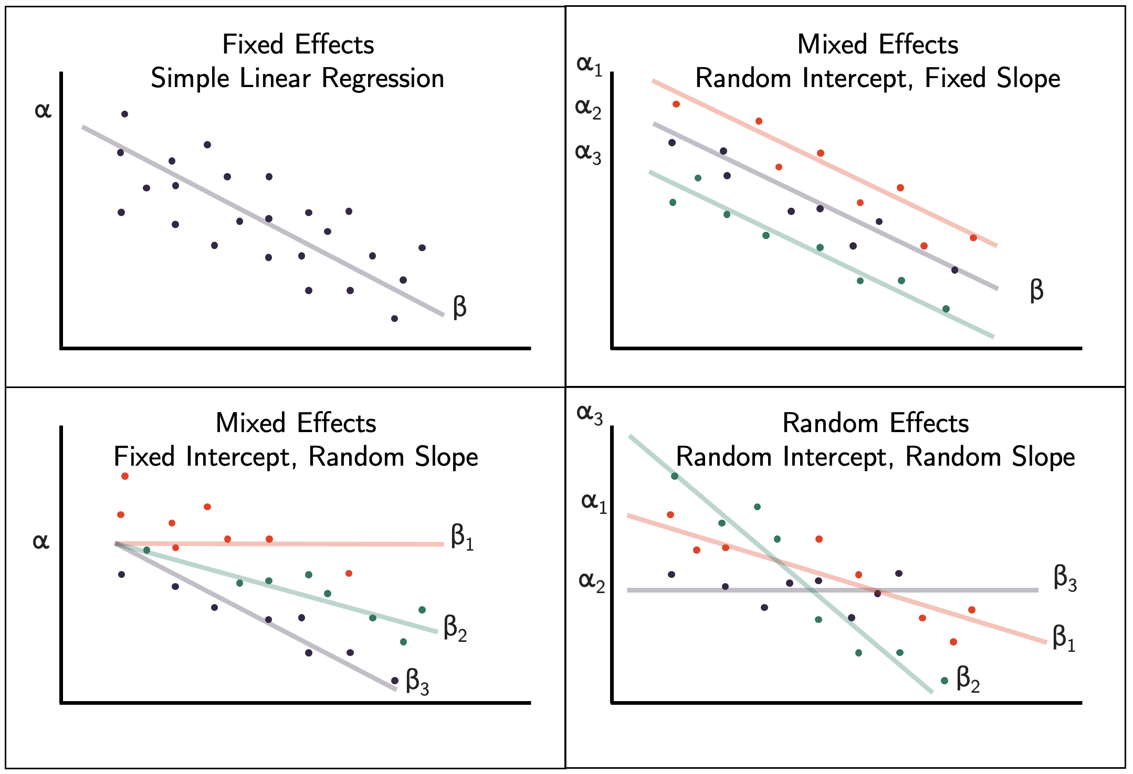
Random effects

Slide 20
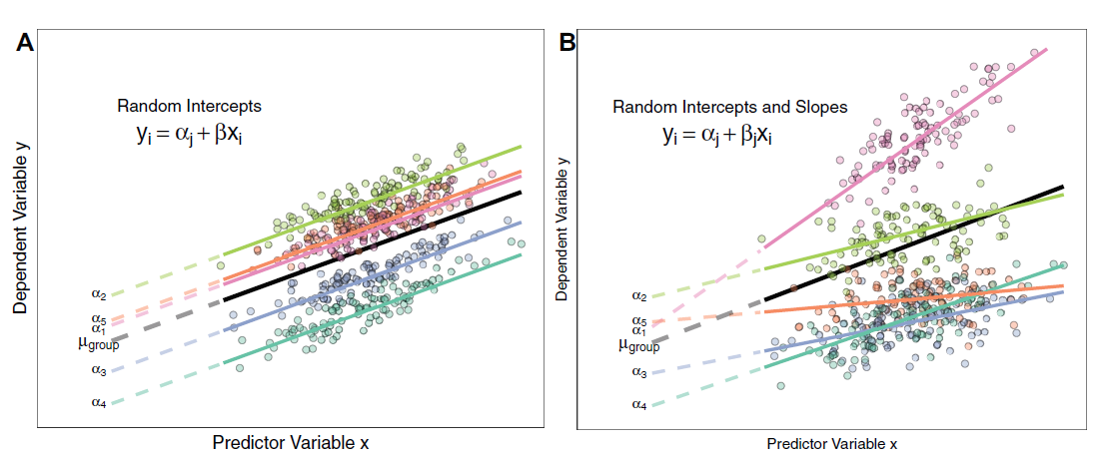
Random effects
Random intercept
Random intercept and slope
lmer(y ~ trt+ (1|site), data=df)
lmer(y ~ trt + (trt|site), data=df)
You will sometimes see “random factors” mentioned in ANOVA, but these take on a different meaning/interpretation (http://www.stat.columbia.edu/~gelman/research/published/banova7.pdf)
Note that “trt” above could be continuous or categorical – mixed-effects models are extremely flexible.
To reduce confusion, some folks suggest referring to random intercepts and slopes as variable intercepts and variable slopes, respectively.

Slide 21
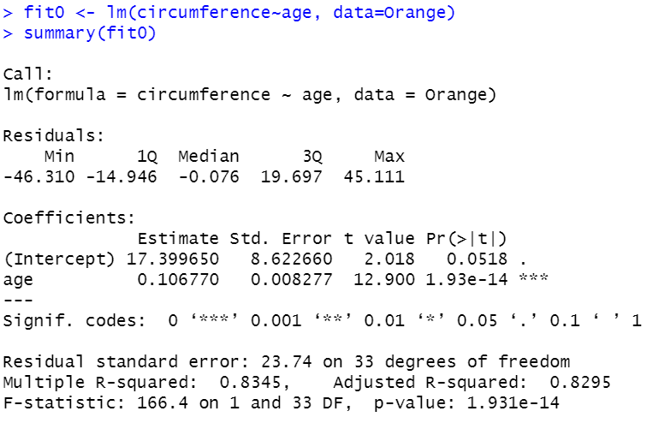
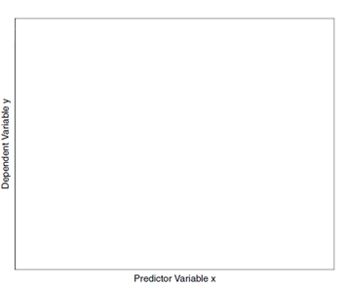
Fixed effects only

Slide 22
library(lmerTest)
The lme4 package will NOT return p-values by default, apparently because there is disagreement on the best way to calculate degrees of freedom when fitting random effects.
The lmerTest package enables use of Satterthwaite’s approximation (default) and other methods, and thus will result in p-values being displayed for lme4 models.

Slide 23
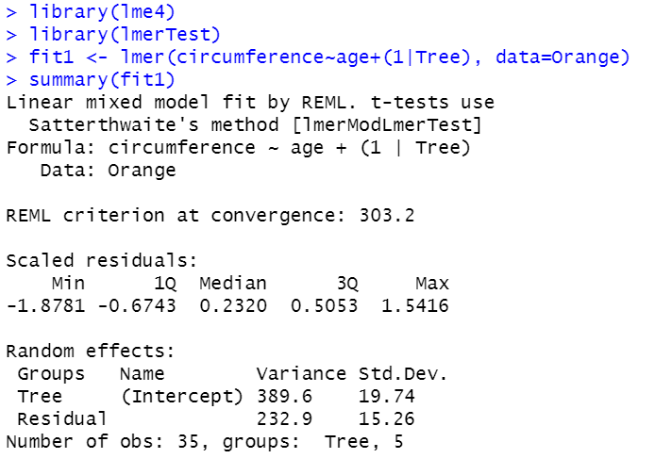
Random intercept

Slide 24
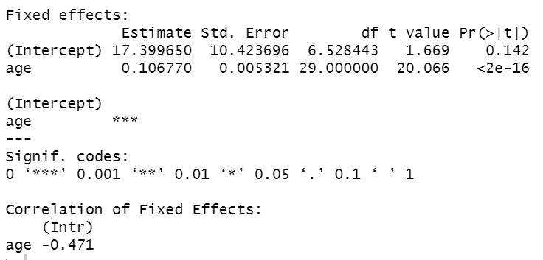
Random intercept

Slide 25
Fixed effects only
Random intercept

Slide 26
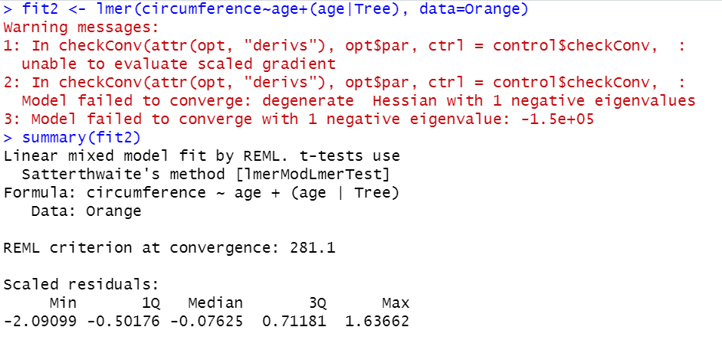
Random intercept and slope

Slide 27
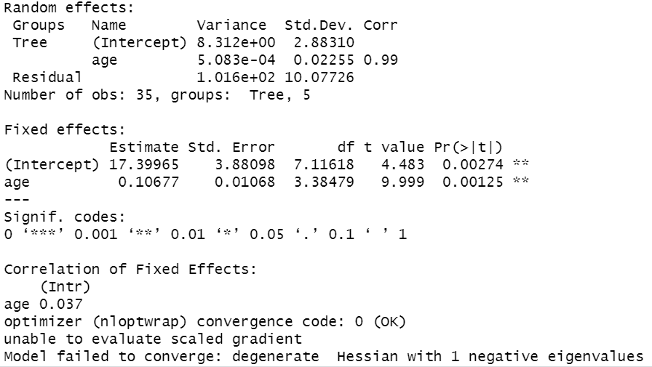
Random intercept and slope

Slide 28

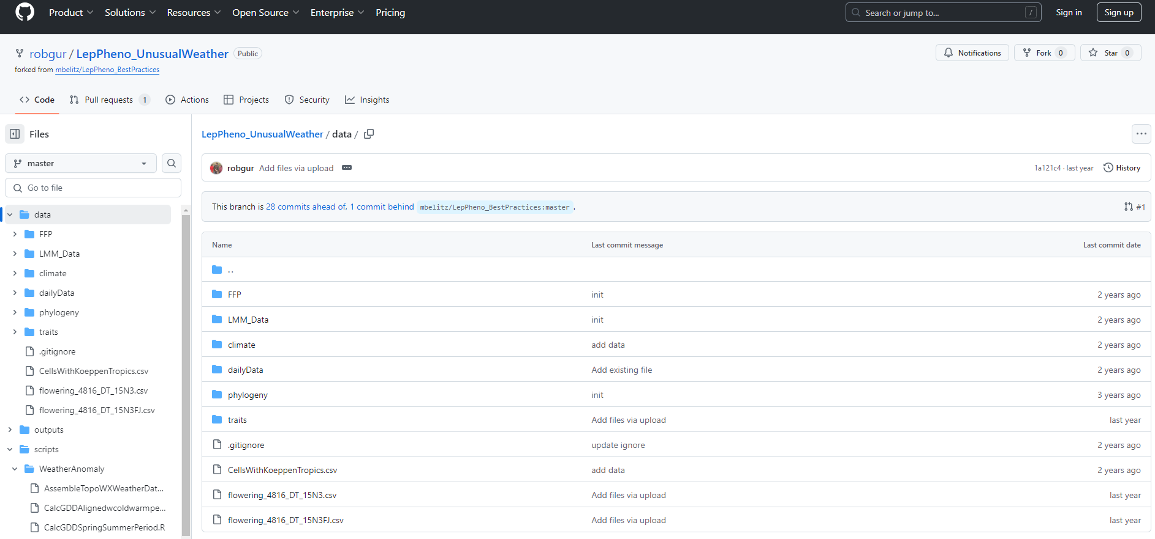

Slide 29
Activity (I will also post this in the chat):
There is a folder on GitHub in week10 (titled “in_class_activity”) with an R project, data, and R script/code. Further instructions are in the R script, but…
Please submit the following to in-class activity 11: a screenshot of the graph, your model output, and a one sentence biological interpretation of the slope from that model.
One submission per group is fine, just make sure to list all group members.
If you are not done by 2:50pm, please just upload your script in its current form at that point and provide one sentence describing where you got stuck.

Slide 30
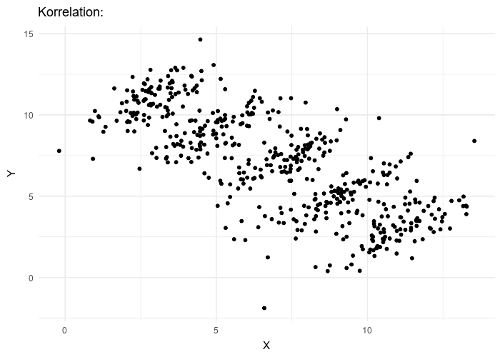
Simpson’s Paradox
When a trend appears in a dataset comprised of several groups, but then disappears or reverses when the grouping structure is accounted for (slightly paraphrased from Wikipedia).
Figure by Pace~svwiki - Own work, CC BY-SA 4.0, https://commons.wikimedia.org/w/index.php?curid=62007681

Slide 31
Assumptions
Linear mixed-effects models are linear models. So, just like simple linear regression, we are trying to fit a line (straight or curvy) through a cloud of points…and thus the same set of assumptions apply:
The relationship between response and predictor is linear
Residuals are independent
Residuals are normally distributed
Residuals are homoscedastic (i.e., the variance in Y does not increase or decrease as X increases or decreases)
We also make the assumptions that our random effects are normally distributed.

Slide 32
Assumptions on random effects

Slide 33
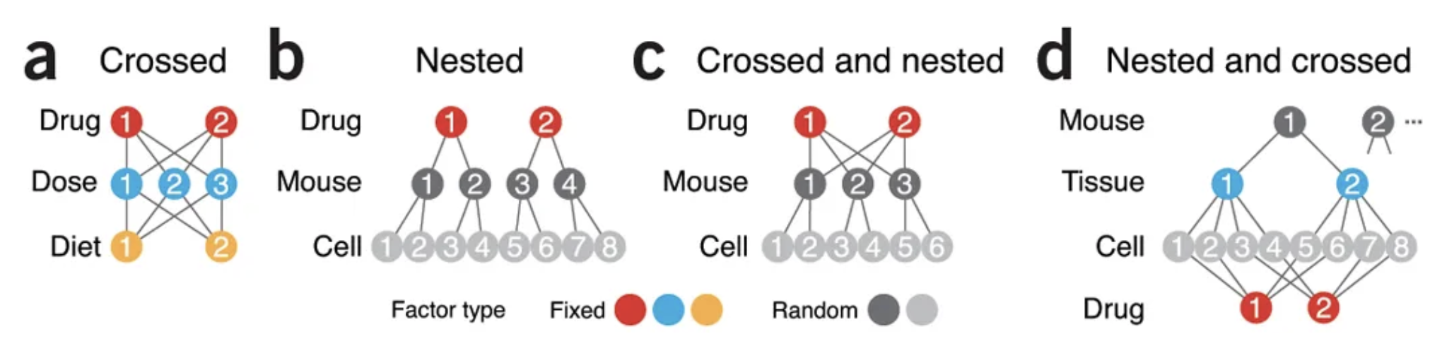

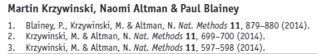
Nested vs. crossed random effects

Slide 34


Nested random effects
fit1 <- lmer(insect size ~ treatment + (1|site/tree/branch), data=df)

Slide 35
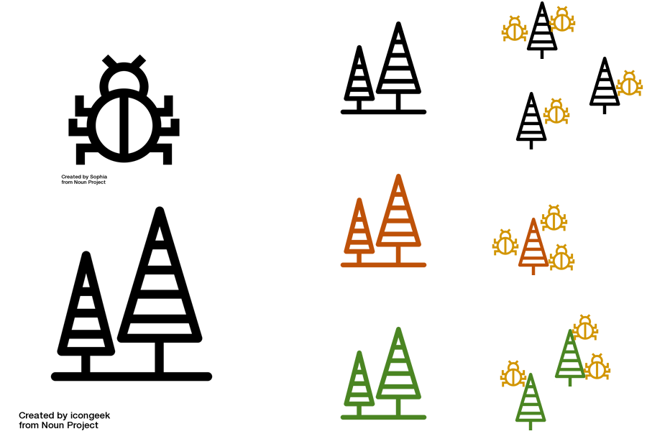
Nested and crossed random effects
Year 1
Year 2
fit1 <- lmer(insect size ~ treatment + (1|site/tree/branch) + (1|year), data=df)

Slide 36
Word of caution on data management
Let’s pretend we are modeling insect size at the branch level
site | tree | unique_ID
1 | 1 | 1_1
1 | 2 | 1_2
2 | 1 | 2_1
2 | 2 | 2_2
3 | 1 | 3_1
3 | 2 | 3_2
site | tree | unique_ID
1 | A | 1_A
1 | B | 1_B
2 | C | 2_C
2 | D | 2_D
3 | E | 3_E
3 | F | 3_F
fit1 <- lmer(insect_size ~ foliage_monoterpenes + (1|site/tree), data=df)
fit1 <- lmer(insect_size ~ foliage_monoterpenes + (1|site) + (1|tree), data=df)

Slide 37
Word of caution on data management
Let’s pretend we are modeling insect size at the branch level
site | tree | unique_ID
1 | 1 | 1_1
1 | 2 | 1_2
2 | 1 | 2_1
2 | 2 | 2_2
3 | 1 | 3_1
3 | 2 | 3_2
site | tree | unique_ID
1 | A | 1_A
1 | B | 1_B
2 | C | 2_C
2 | D | 2_D
3 | E | 3_E
3 | F | 3_F
fit1 <- lmer(insect_size ~ foliage_monoterpenes + (1|site/tree), data=df)
fit1 <- lmer(insect_size ~ foliage_monoterpenes + (1|site) + (1|tree), data=df)

Slide 38
df$unique_ID <- paste(df$site, df$tree, sep=“_”)
site | tree | unique_ID
1 | 1 | 1_1
1 | 2 | 1_2
2 | 1 | 2_1
2 | 2 | 2_2
3 | 1 | 3_1
3 | 2 | 3_2

